Slide 1
[Organisation] · PHASE C
Data Migration
Six migrations, 2.6 million party records, and the four masters that become one
6 migrations · 14 source-to-target mappings · 0 gates met
0.1 — Draft · June 2027

Slide 2
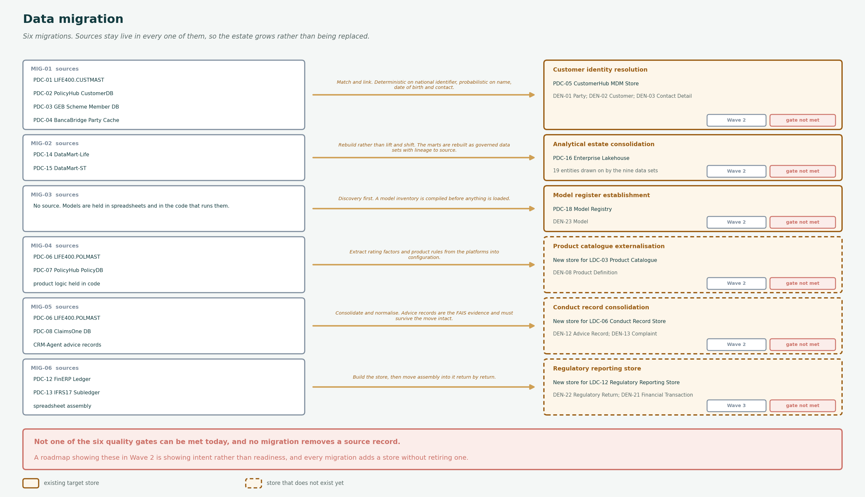
DATA MIGRATION
Six migrations, source to target
A dashed target is a store that does not exist yet. Entity-level source-to-target mappings are in the workbook.

Slide 3
APPROACH
Five rules
The last one is a consequence rather than a choice, and it belongs in the funding case.
Match and link, never merge
Party records are linked to one enterprise identity. No source record is overwritten or combined.
ADR-031. A merge cannot be undone, and the match rate is not high enough to justify one.
Sources stay live
The four masters continue to run. The hub holds the link, not the record.
A migration that switches off a source needs a confidence in the target that [Organisation] does not yet have.
Load in confidence bands
High-confidence matches load automatically. Everything below the threshold queues for a data steward.
The queue is the control. A migration with no queue has decided that being wrong is acceptable.
Quality gate before cutover, not after
Each migration has a stated gate. If the gate is not met, the wave does not proceed.
Three of the six gates cannot be met today, which is stated here rather than discovered at cutover.
Nothing is deleted
No source record is removed by any migration in this plan.
That is consistent with the estate, which disposes of nothing. It also means every migration adds storage rather than replacing it.
Match and link rather than merge is ADR-031. A merge cannot be undone, and the match rate is not high enough to justify one.

Slide 4
QUALITY GATES
Not one gate can be met today
Each migration has one gate that must be met before cutover. All six are currently unmet, which is why this is a plan and not a schedule.
MIG-01
Customer identity resolution
95% of presented parties resolved; false-match rate below 0.1%; every unresolved candidate queued
Roughly 640,000 records cannot currently be matched. The 95% target is an estimate, not a measured achievable rate.
MIG-02
Analytical estate consolidation
Every reported figure traceable to source; no departmental mart holding an authoritative copy
R21 records the platform against three entities and the data sets draw on nineteen. The migration scope cannot be sized until that is corrected.
MIG-03
Model register establishment
Every model in production has a register entry, an owner and a monitoring status
There is no source system to migrate from. The first task is finding out how many models are in production.
MIG-04
Product catalogue externalisation
A rating factor changes in under a week; no product change requires a code deployment
For the nine coded products the rules are not data anywhere. They are behaviour in a program, and extracting them is analysis rather than migration.
MIG-05
Conduct record consolidation
Conduct outcomes reportable from source without manual assembly, currently 12%
The advice record carries a five-year FAIS retention obligation. A migration that loses one is a regulatory event, not a data quality issue.
MIG-06
Regulatory reporting store
No manual spreadsheet step between source and return; submission evidence held in one place
The current basis of preparation exists only in the spreadsheets. Documenting it is a prerequisite and is not scoped.
Two of the six have no source system at all. They are discovery exercises that produce data which is then loaded, and estimating them as migrations will understate them.

Slide 5
MAPPING
Source to target, entity by entity
Fourteen mappings. The rule is what gets built from; the quality issue is what will make it fail.
Mig
Entity
Source
Target
Rule
Quality issue
MIG-01
Party
LIFE400.CUSTMAST party record
CustomerHub party
Deterministic match on national identifier where present
Identifier absent or malformed on roughly 18% of funeral book records
MIG-01
Party
PolicyHub CustomerDB party
CustomerHub party
As above, then probabilistic on name and date of birth
Date of birth quality poor in the funeral book
MIG-01
Party
GEB Scheme Member DB member
CustomerHub party
Membership is not a party. A member resolves to a party; the membership stays with the scheme
Scheme membership has been treated as a customer record
MIG-01
Party
BancaBridge Party Cache party
CustomerHub party
Match under the partner agreement. Lawful basis must travel with the record
Partner contract limits what may be retained
MIG-01
Customer
Derived across all four sources
CustomerHub customer
A customer exists where a resolved party holds or has held cover
Customer is created by no function today, so the rule is new
MIG-01
Contact Detail
Contact rows from all four sources
CustomerHub contact
Deduplicate by type and value; preserve the most recently verified
Verified date is not populated consistently
MIG-02
Policy
DataMart-Life and DataMart-ST policy tables
Lakehouse governed data set
Rebuild from the operational source, not from the mart
Mart definitions have drifted from source and the drift is not documented
MIG-02
Financial Transaction
FinERP ledger extract
Lakehouse governed data set
Rebuild with lineage to the posting
IFRS 17 measurement model attribute is not carried today
MIG-03
Model
Spreadsheets and embedded code
Model Registry
Manual inventory then registration
No inventory exists; the count is unknown
MIG-04
Product Definition
Product tables plus rules held in COBOL and PL/SQL
Product Catalogue configuration
Extract to configuration. Nine products need the rules recovered from code
Rating basis for coded products is not held as data anywhere
MIG-05
Advice Record
Advice records in CRM-Agent, BrokerNet and WebQuote
Conduct Record Store
Consolidate, normalise, retain the original
FAIS five-year retention applies to every record moved
MIG-05
Complaint
Complaint records in CRM-Agent
Conduct Record Store
Direct move with category mapping to COFI outcomes
COFI outcome categories do not exist on the current records
MIG-06
Regulatory Return
Spreadsheet assembly per return
Regulatory Reporting Store
Rebuild the assembly as a repeatable extract
Basis of preparation is undocumented outside the spreadsheets
MIG-06
Financial Transaction
IFRS17 Subledger contract level
Regulatory Reporting Store
Direct extract with lineage
Contract grouping logic is inside the sub-ledger
Every mapping carries a quality issue that must be resolved before the rule can run. That column is the real work.

Slide 6
FINDINGS
What the migration plan shows
Not one of the six quality gates can be met today
Every migration has a stated gate, and every gate is currently Not met.
That is the point of stating them before cutover rather than after. It also means no migration in this plan is ready to schedule, and a roadmap that shows them in Wave 2 is showing intent rather than readiness.
Two migrations have no source system
The model register has no inventory, and the product catalogue has to recover rules from COBOL and PL/SQL.
Neither is a migration in the usual sense. Both are discovery exercises that produce data which is then loaded, and estimating them as migrations will understate them.
The largest migration cannot be sized
The analytical consolidation covers three entities in R21 and nineteen in the data sets.
Until the platform's actual footprint is recorded, the scope of MIG-02 is unknown. Recording it is cheap and is a prerequisite to estimating anything.
No migration deletes a source record
All four customer masters stay live after MIG-01, by design under ADR-031.
That is the right call for identity, and it means the estate grows. Every migration in this plan adds a store without retiring one, which should be stated in the funding case rather than assumed away.
The conduct migration carries a regulatory consequence the others do not
Advice records are FAIS evidence with a five-year retention obligation.
Losing a policy record in a migration is a data quality incident. Losing an advice record is a regulatory one, and the two should not be run at the same risk appetite.
Losing a policy record in a migration is a data quality incident. Losing an advice record is a regulatory one.

